Slide 1
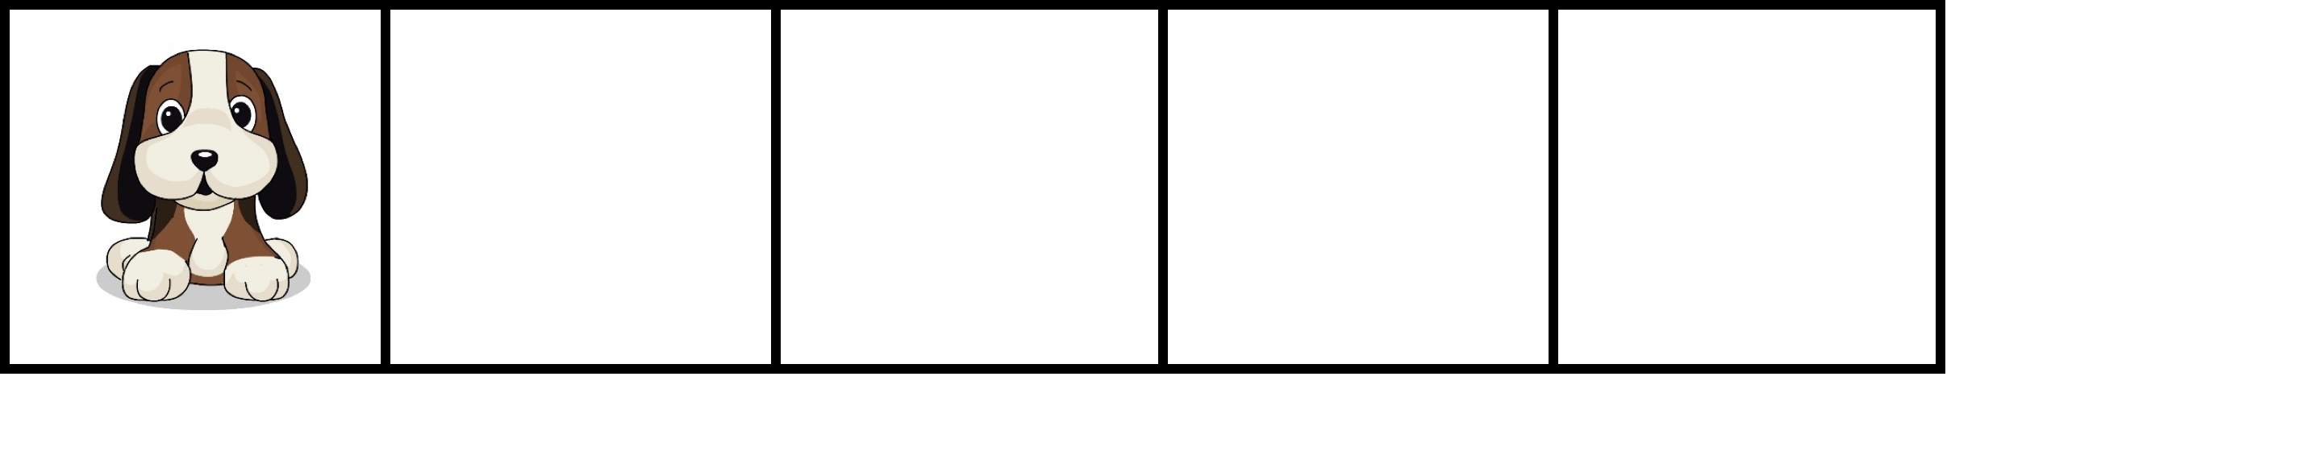
How many?

Slide 2
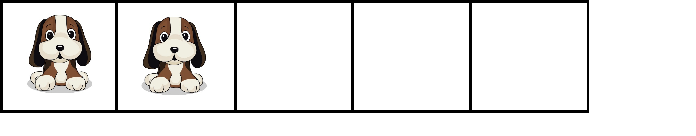
How many?

Slide 3
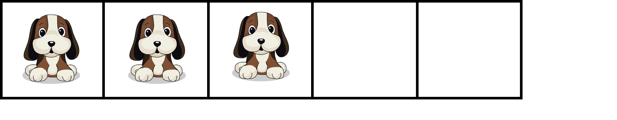
How many?

Slide 4
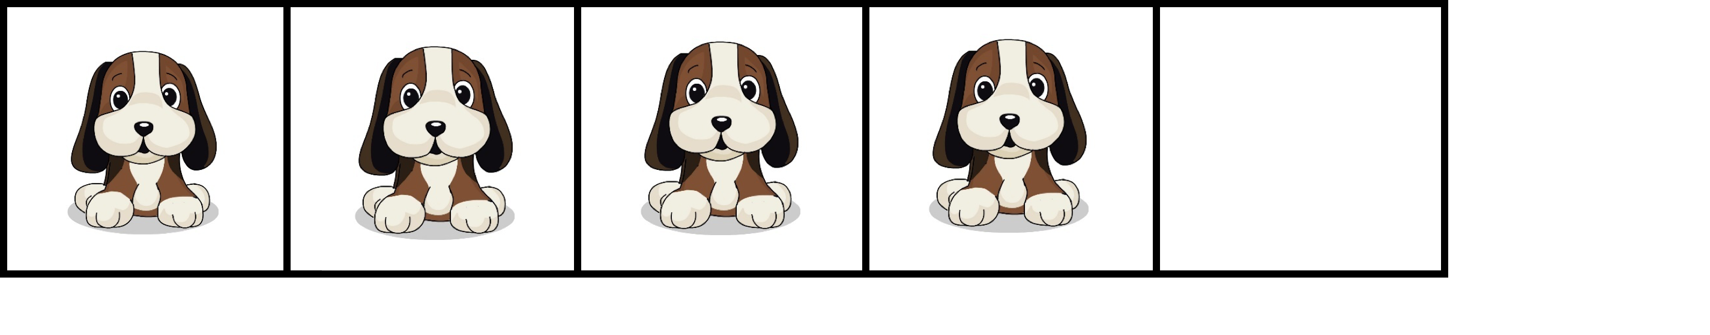
How many?

Slide 5
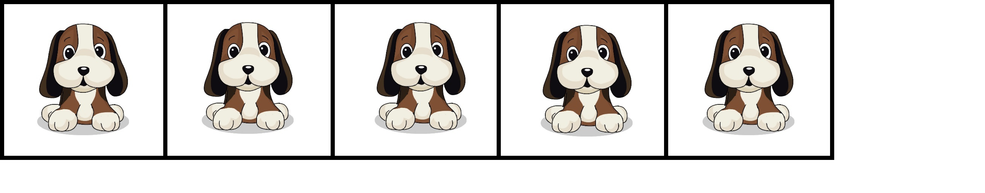
How many?

Slide 6
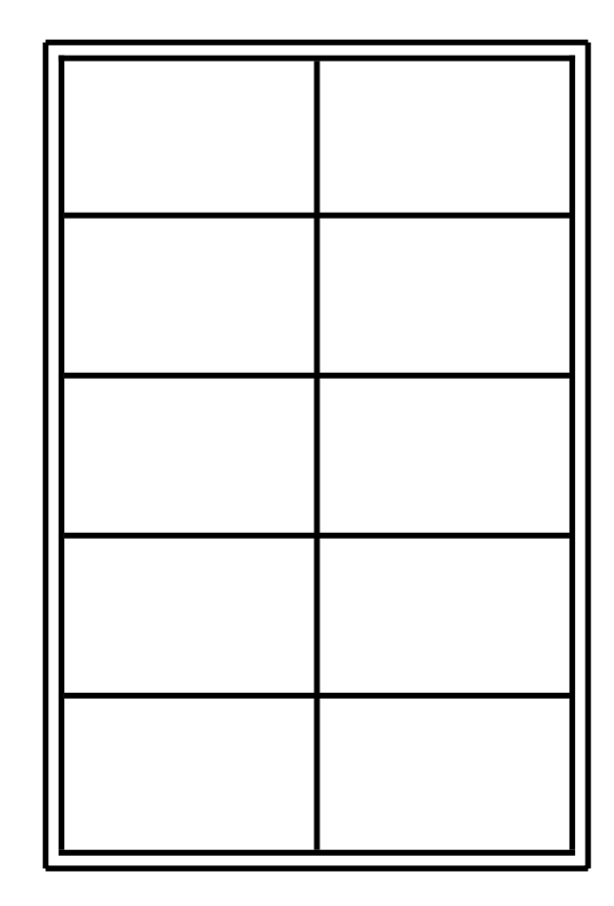

How many?

Slide 7
How many?

Slide 8
How many?

Slide 9
How many?

Slide 10
How many?

Slide 11
How many?

Slide 12
How many?

Slide 13
How many?

Slide 14
How many?

Slide 15
How many?

