Slide 1
Easter Estimating
lynwen.barnsley@gmail.com
@BarnsleyLynwen
Idea inspired by www.stevewyborney.com

Slide 2
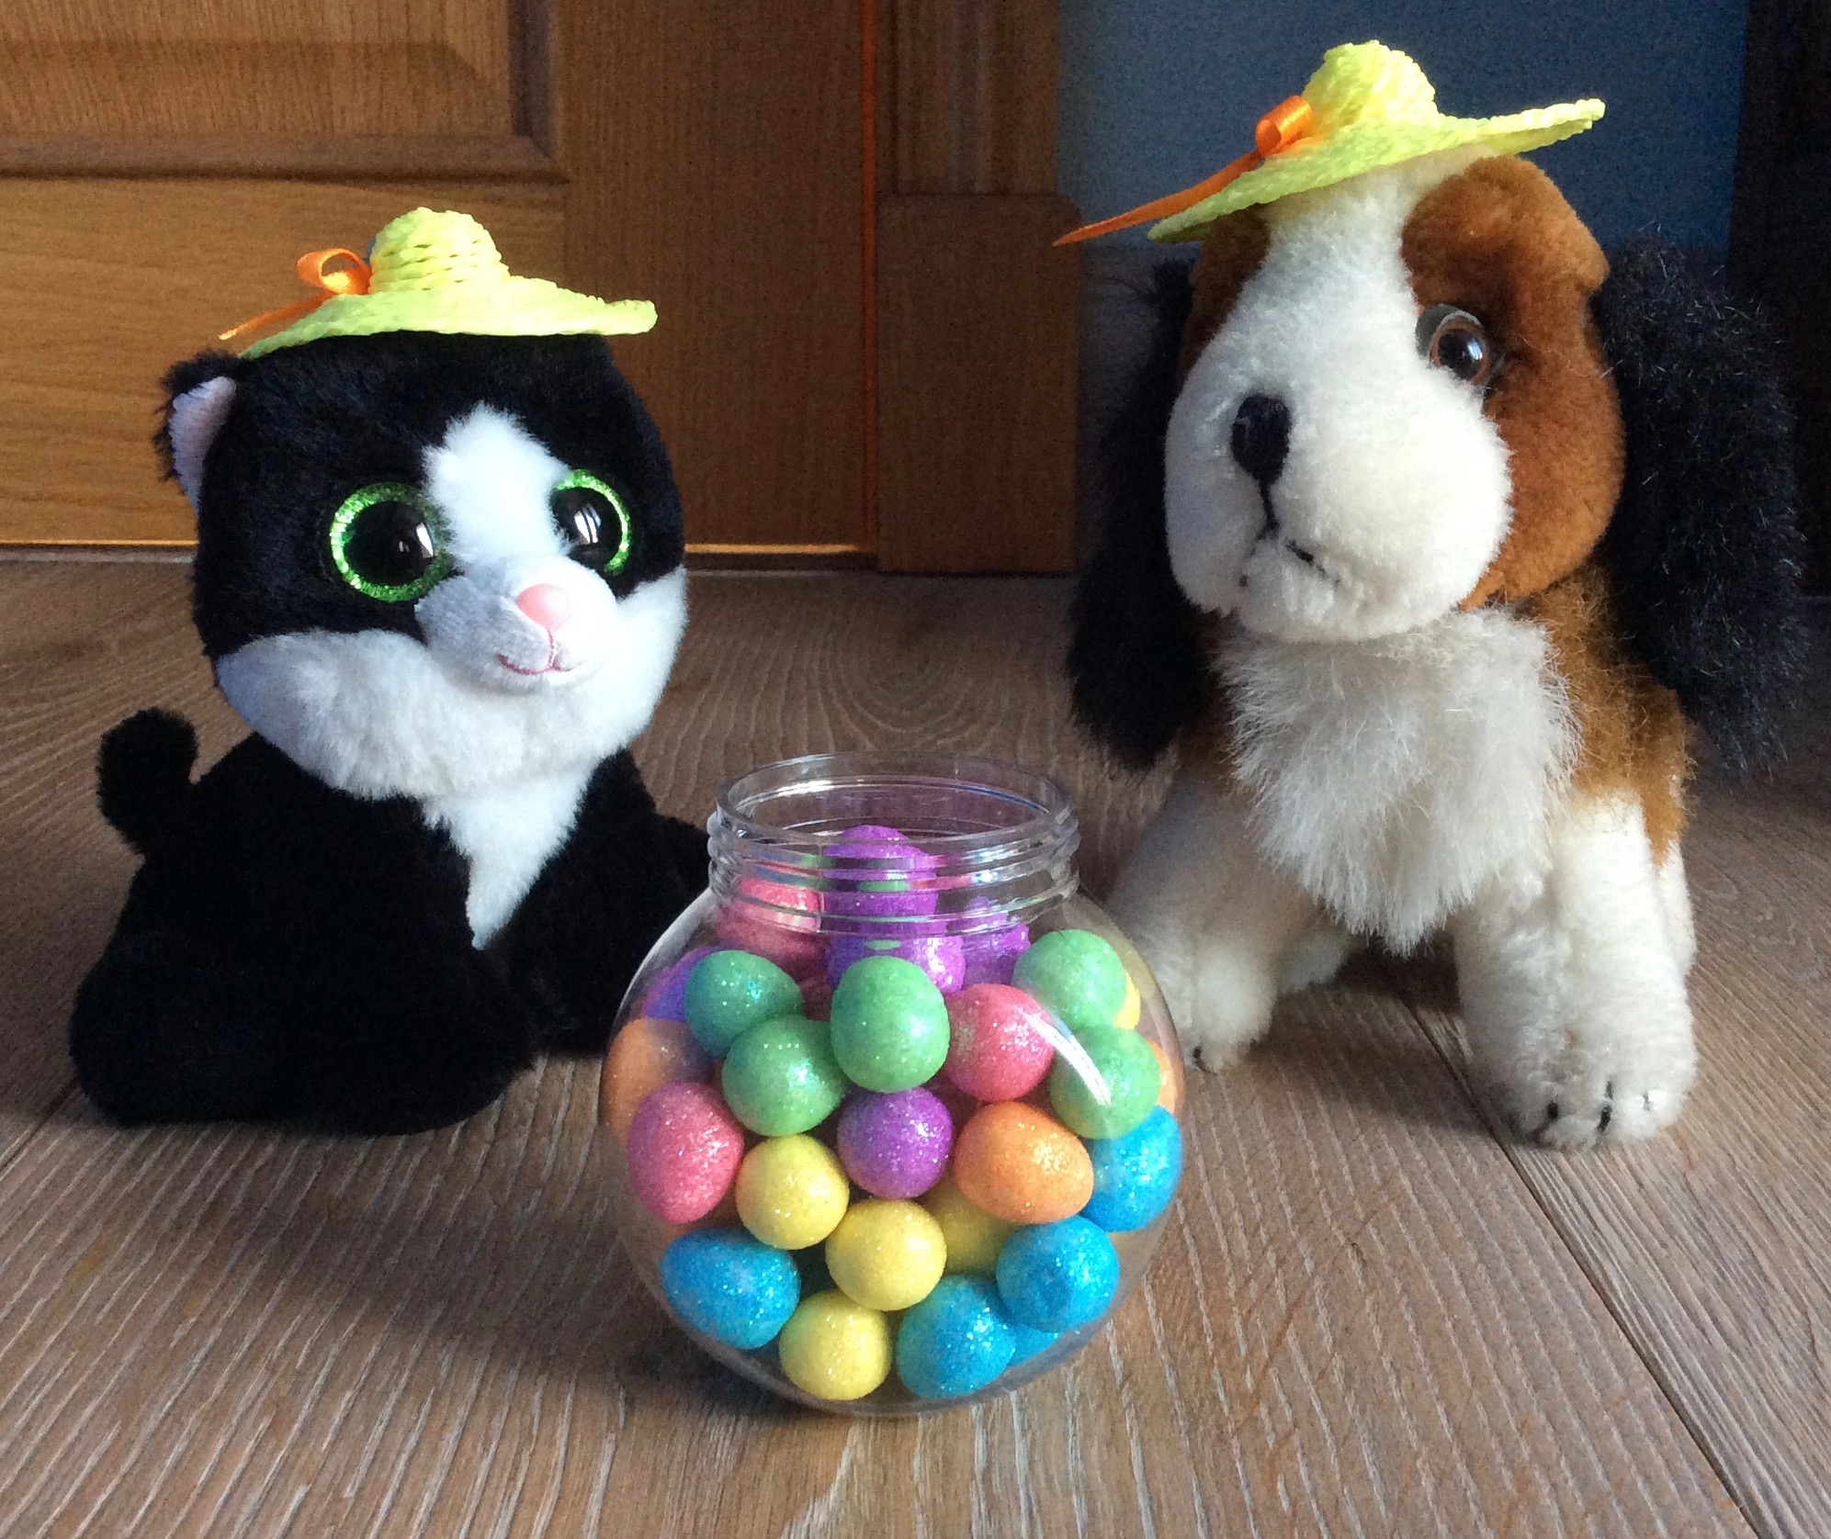
I wonder how many eggs are in the pot
The answer
50 eggs

Slide 3
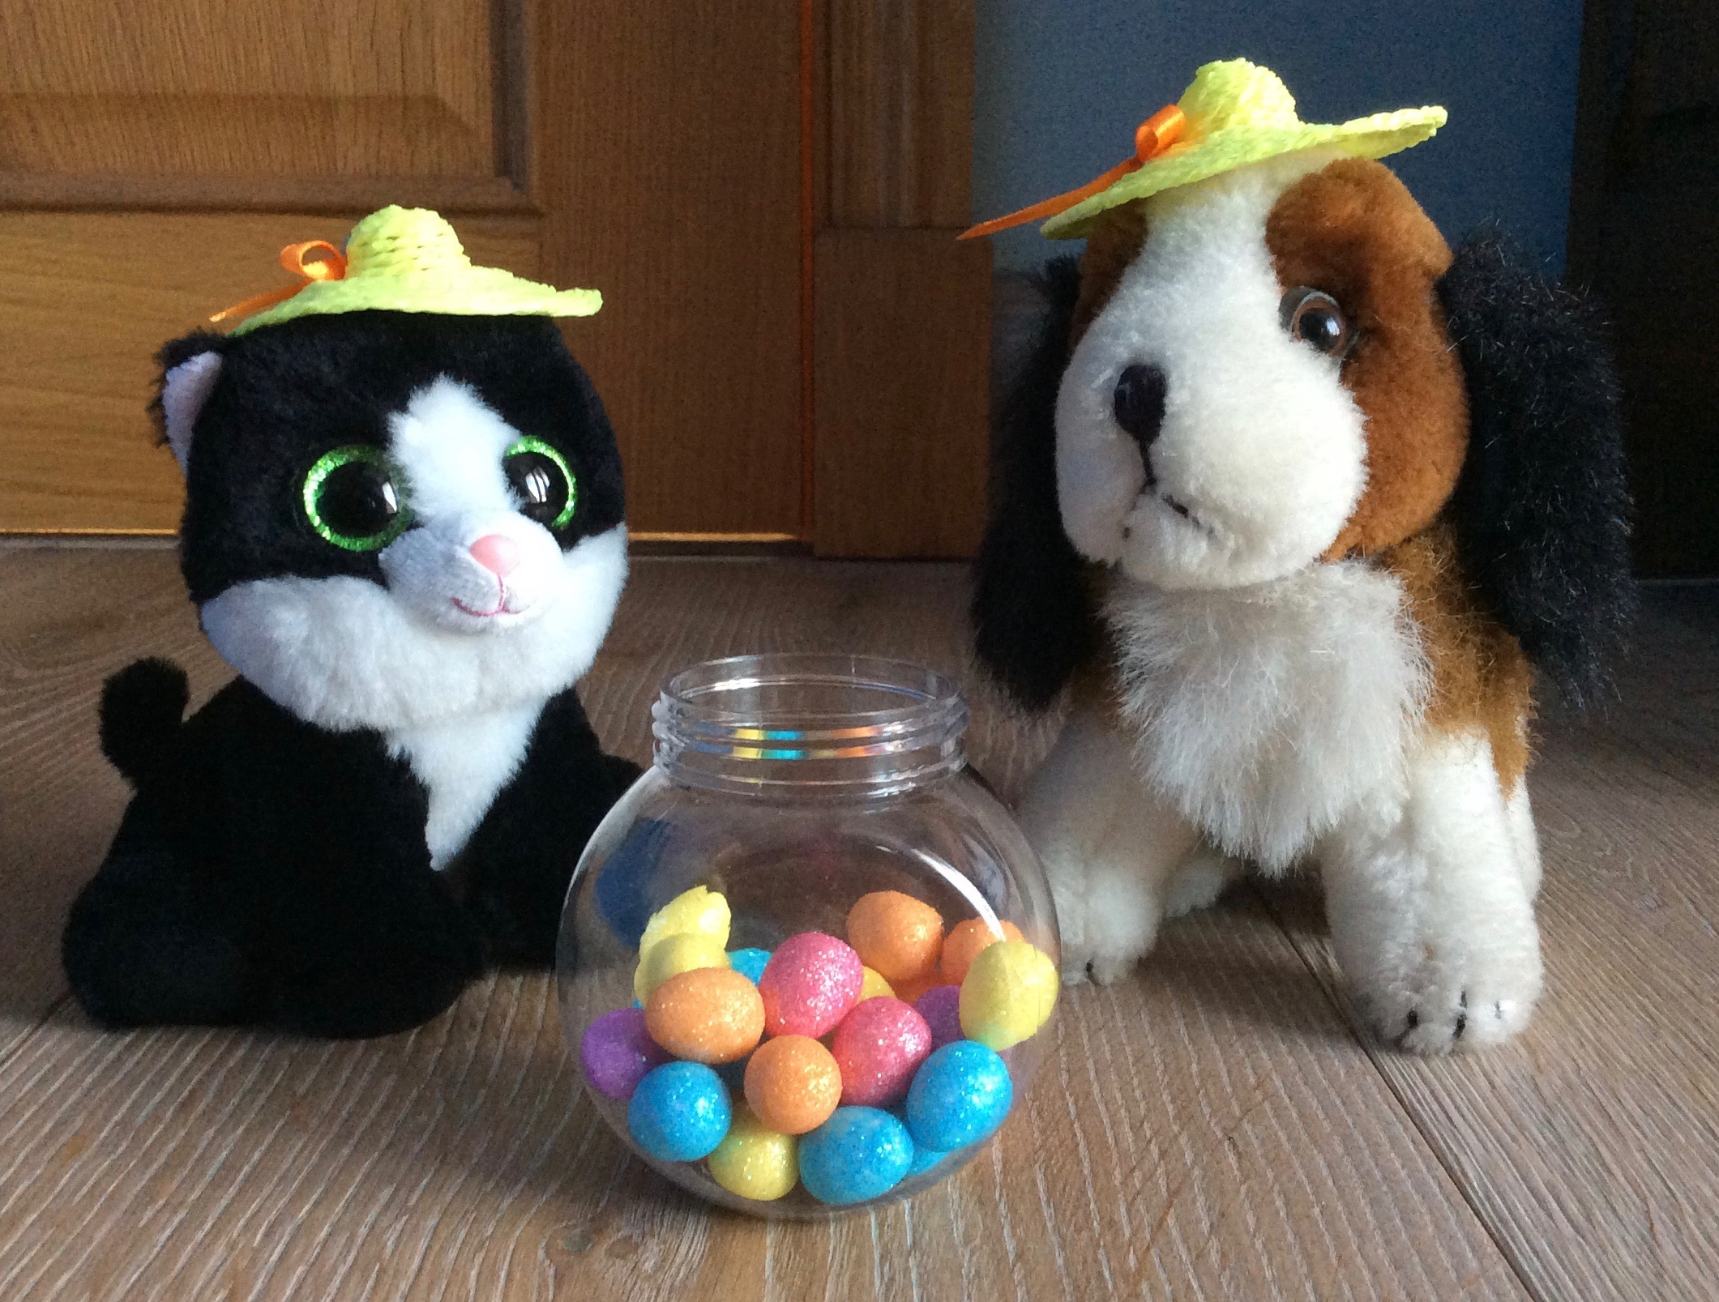
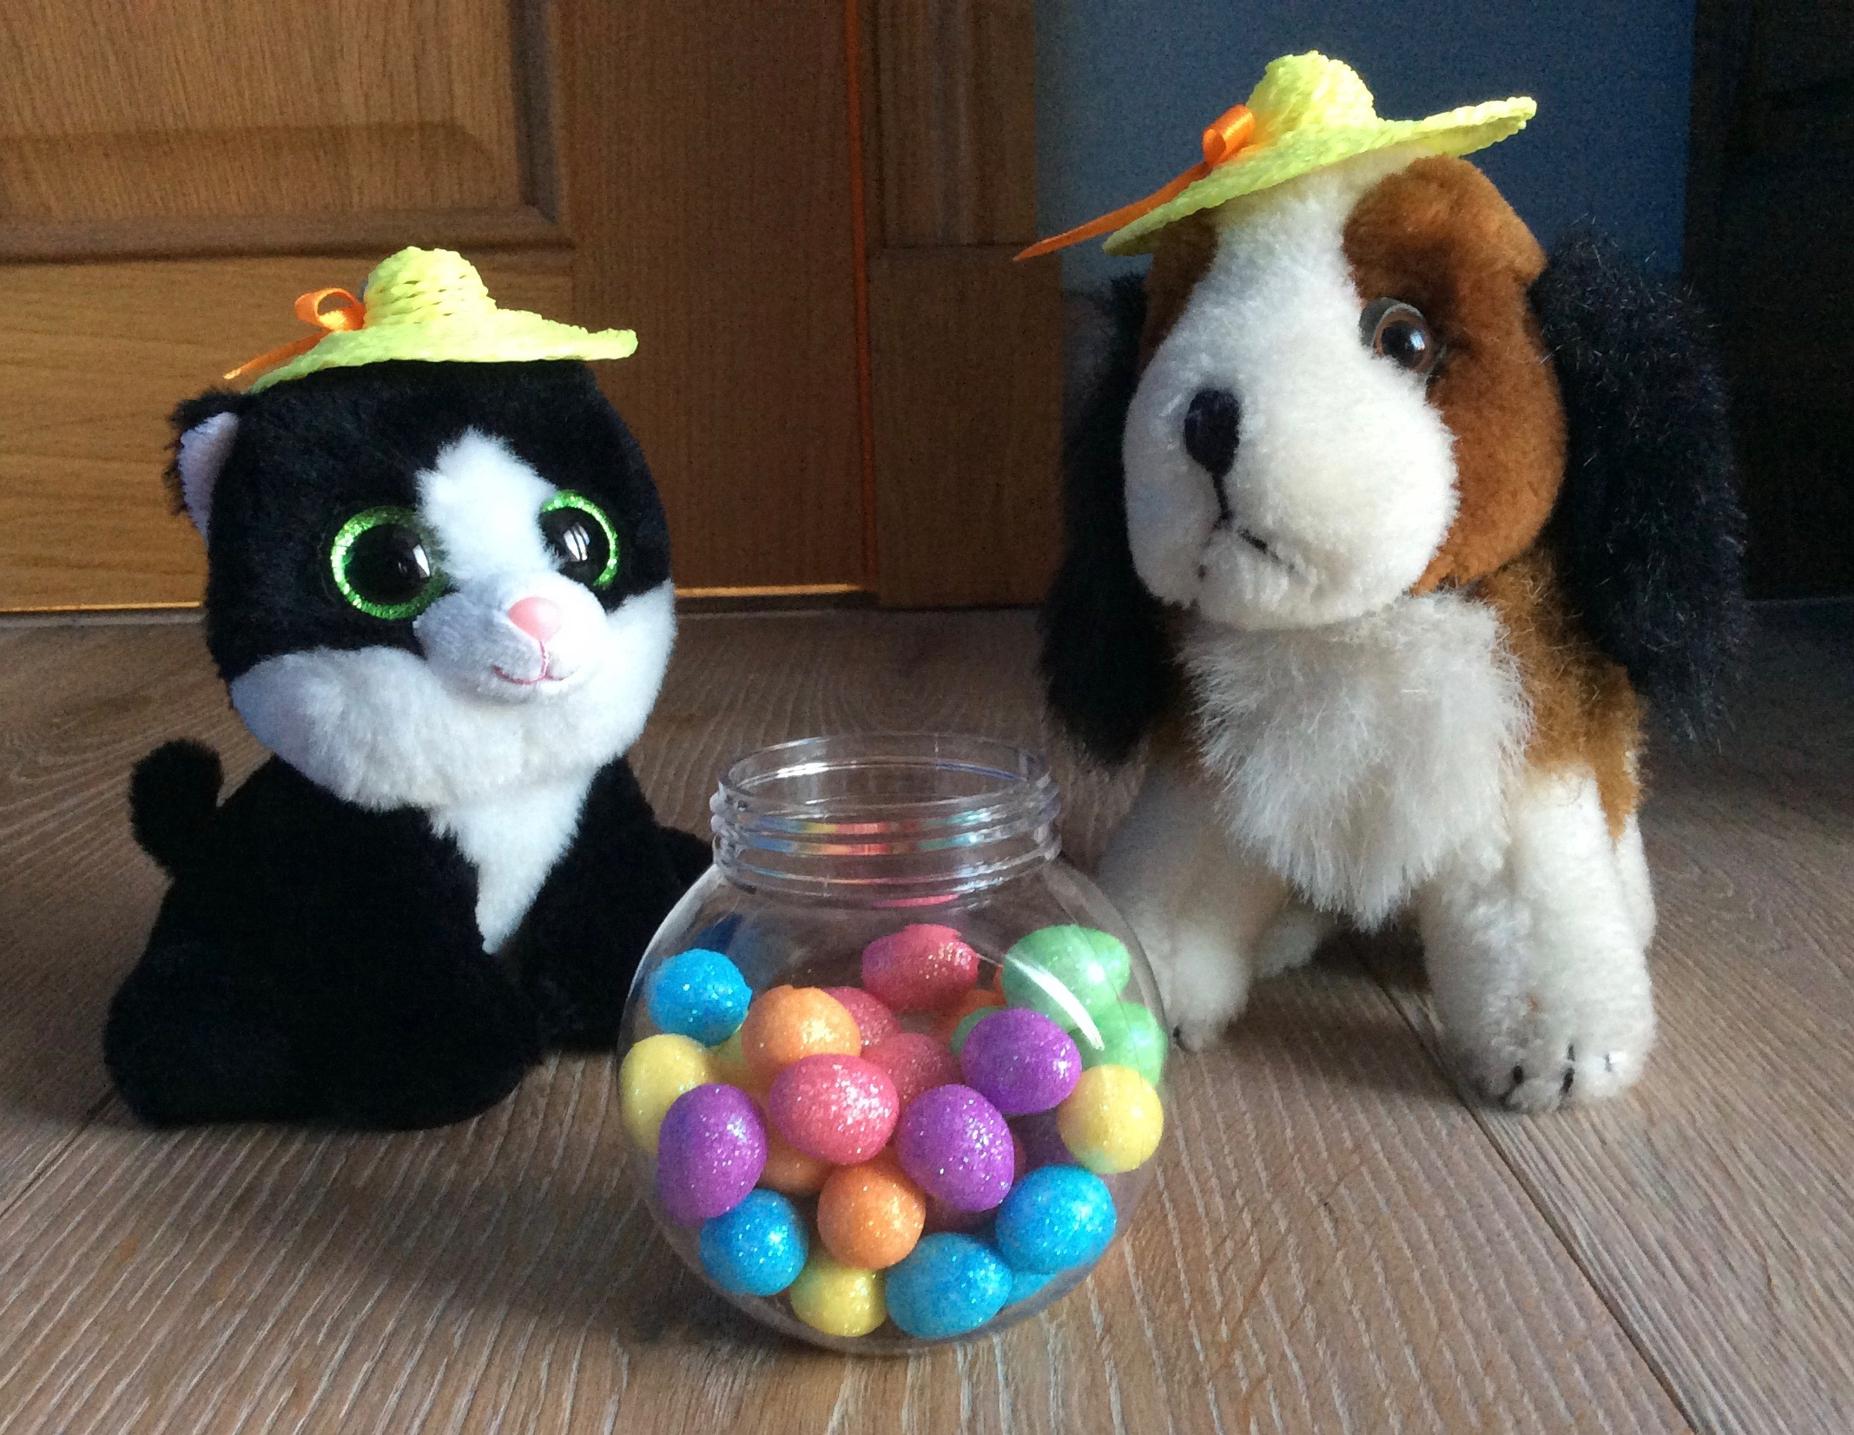
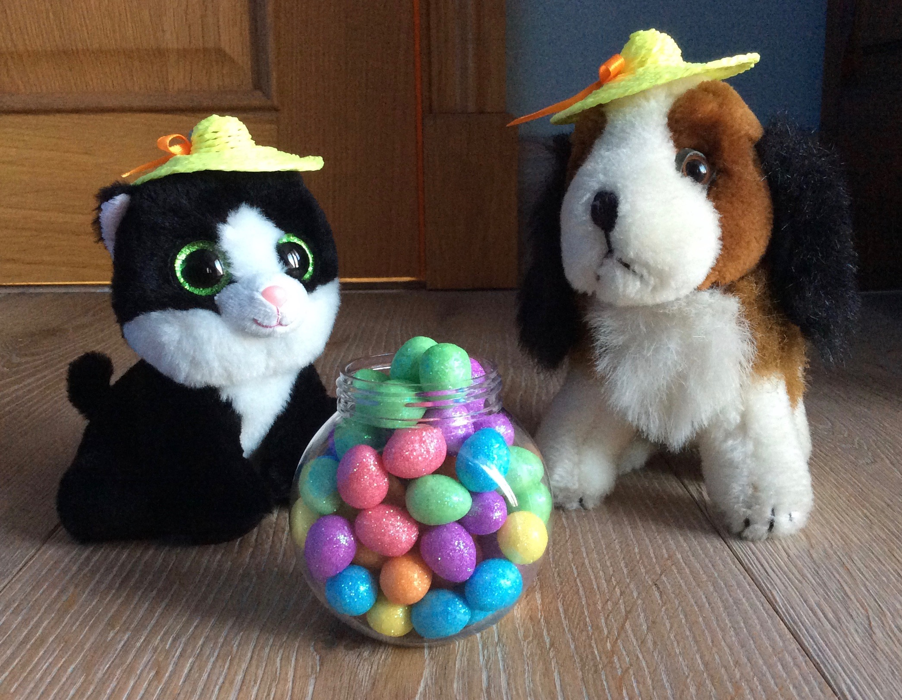
50 eggs
26 eggs
Answer
Answer
39 eggs
59 eggs
Answer

